Slide 1
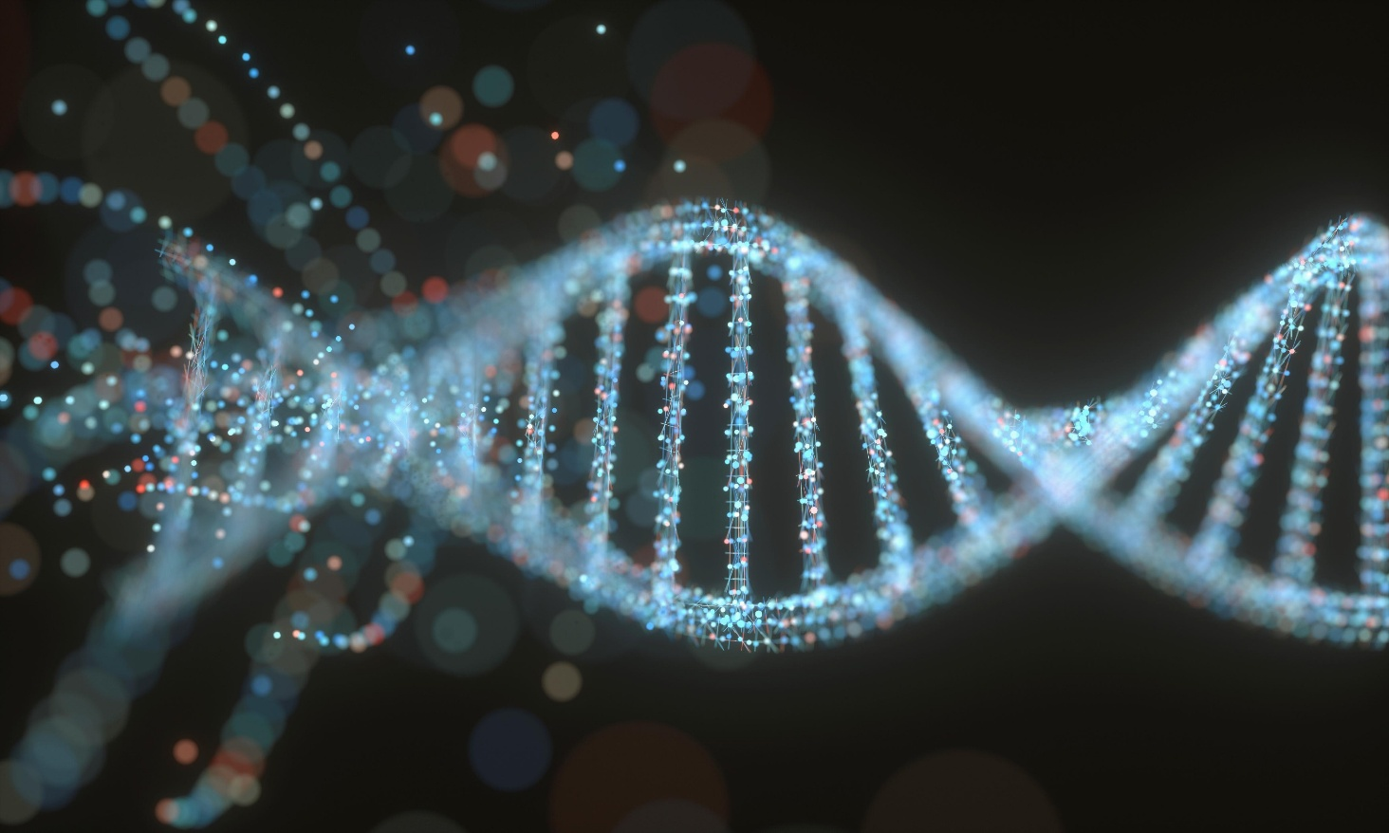

SCI225 · PATHOPHYSIOLOGY
Week One
Foundations: Genetics & Cellular Biology
Prof. XYZ Nightingale College
// week 1 visual
Notes:
Welcome to Week 1. Introduce yourself and frame the course.

Slide 2

TODAY'S SESSION
Agenda
01
Welcome & webinar reminders
02
Course logistics & Canvas tour
03
What is pathophysiology?
04
Genetics & epigenetics
05
Cellular biology & injury
06
Fluids, electrolytes, acid–base
SCI225 · WEEK 1
02 / 38
Notes:
Walk through the agenda for today.

Slide 3
BEFORE WE GET STARTED
A few reminders
Webinar sessions are recorded — anything shared via webcam, audio, or chat may be part of the recording.
Live captioning is available — open More → Captions in the meeting toolbar.
Interaction features include text chat, reactions (raise hand, thumbs up), microphone, and webcam.
Please participate in whatever way feels most comfortable.
SCI225 · WEEK 1
03 / 38
Notes:
Cover webinar housekeeping.

Slide 4
YOUR INSTRUCTOR
Introduction
Name: Prof. XX
Email: XYZ@nightingale.edu
Phone: XX
Office hours: Booking link [share]
Webinars: XX at XX am/pm MT
SCI225 · WEEK 1
04 / 38
Notes:
Introduce yourself in detail.

Slide 5
LOGISTICS
Important dates & times
Nightingale College operates on Mountain Time (MT).
School week runs 12 am MT Monday – 11:59 pm MT Sunday.
Semester dates: XX – XX, ending 5 pm MT.
SCI225 · WEEK 1
05 / 38
Notes:
Important dates and Mountain Time reminders.

Slide 6
COURSE PLATFORM
Navigating the Canvas classroom
Course homepage: Recent Announcements — daily check.
Modules — week-by-week content and assessments.
Webinar Links — under HOME, choose SCI tab → SCI225.
Grades, Help Desk, Learner Forms — left navigation.
SCI225 · WEEK 1
06 / 38
Notes:
Brief tour of Canvas Classroom.

Slide 7
FIRST-WEEK CHECKLIST
Canvas priorities
Read the syllabus end-to-end.
Bookmark the course homepage and webinar links page.
Confirm your email + notification preferences in Canvas.
Locate the textbook in Course Resources.
Open the Week 1 module and start the preassessment.
SCI225 · WEEK 1
07 / 38
Notes:
Highlight Canvas priorities.

Slide 8
HOW TO ATTEND
How to access the webinars
Attend my webinars on [Day] at [XX] [am/pm] MT.
You can also attend any other pathophysiology webinar that fits your schedule.
From the course homepage: HOME → Webinar Links.
Click the SCI tab, then SCI225: Pathophysiology.
Click the link under Webinar Link to join live.
Recordings are linked at the bottom of the same page.
SCI225 · WEEK 1
08 / 38
Notes:
Show how to access webinars.

Slide 9
SUPPORT
Learner tools
Nightingale Math Lab — drop-in tutoring for quantitative coursework.
Writing Center — paper review and structure feedback.
Paper Review Submission Form — formal feedback before submission.
How to access my eBook — link in Course Resources.
SCI225 · WEEK 1
09 / 38
Notes:
Point out Learner Tools.

Slide 10
EACH WEEK
Weekly resources
Weekly module landing page with objectives, readings, and assessments.
Pre-assessment to anchor your starting point.
Required textbook chapters from Understanding Pathophysiology, 8th Ed.
Webinar recording posted within 24 hours.
SCI225 · WEEK 1
10 / 38
Notes:
Walk through weekly resources.

Slide 11
ANCHOR YOUR STUDY TIME
Weekly study guides
Posted in each weekly module — covers every learning objective.
Use it to drive your reading and to self-quiz before the webinar quiz.
Pair with the textbook chapters and your webinar notes.
SCI225 · WEEK 1
11 / 38
Notes:
Highlight the weekly study guides.

Slide 12

01
MODULE ONE
Week One
Foundations of pathophysiology — genetics, epigenetics, cellular biology, fluids, and acid–base.
SCI225 · WEEK 1
12 / 38
Notes:
Open Module 1 — Week One core content.

Slide 13
WEEK ONE
Learning objectives
1
Understand the vast array of human genes and genetic diseases.
2
Define epigenetic and related genetic diseases.
3
Define altered states of both cellular and tissue biology.
4
Describe alterations in fluid balance and acid–base regulation.
SCI225 · WEEK 1
13 / 38
Notes:
State the Week 1 learning objectives.

Slide 14
ACTION ITEMS
What is due this week?
Complete the Week 1 Pre-assessment.
Read Chapters 2, 3, 4, and 5 — Genetics, Epigenetics, Altered Cells, Fluids & Electrolytes.
Attend a Week 1 Webinar.
Complete the Week 1 Case Study.
Take the Week 1 Webinar Quiz.
SCI225 · WEEK 1
14 / 38
Notes:
Cover what is due this week.

Slide 15
FOUNDATIONS
Pathophysiology
patho-
physio-
-logos
Greek pathos — suffering
functions of an organism
discourse / formal study
Pathophysiology is the study of underlying changes in body physiology — molecular, cellular, and organ-system — that result from disease or injury, including the inextricable component of suffering and its psychological, spiritual, social, cultural, and economic implications.
SCI225 · WEEK 1
15 / 38
Notes:
Define pathophysiology — etymology breakdown.

Slide 16
SECTION · GENETICS
Section objectives
1
Understand the vast array of human genes and genetic diseases.
2
Define epigenetics and related genetic diseases.
SCI225 · WEEK 1
16 / 38
Notes:
Read out the section objectives.

Slide 17
DNA
Discussion prompts — let learners answer aloud:
What is DNA?
What are its components?
How do the bases pair up?
What is it responsible for?
// DNA helix image
Notes:
Quick DNA review — let learners answer aloud.

Slide 18
Replication, transcription, translation
→
→
STEP 01
STEP 02
STEP 03
Replication
Transcription
Translation
DNA copies itself before cell division — semi-conservative; one parental and one new strand.
DNA template → mRNA in the nucleus. RNA polymerase reads 3'→5'.
mRNA → protein at the ribosome. tRNA delivers amino acids by codon.
SCI225 · WEEK 1
18 / 38
Notes:
Replication, transcription, translation refresh.

Slide 19
MEMORIZE THESE
Keeping track of the numbers
Humans have 46 chromosomes in somatic cells (diploid).
Gametes have 23 chromosomes (haploid) due to meiosis.
Male gamete: sperm.
Female gamete: secondary oocyte.
SCI225 · WEEK 1
19 / 38
Notes:
Anchor the chromosome numbers.

Slide 20
GENETIC VARIATION
Mutations
Point mutations — silent, missense, nonsense.
Frameshift — insertion or deletion shifts the reading frame.
Chromosomal — translocation, inversion, deletion, duplication.
Cause: spontaneous error, mutagens (radiation, chemicals), viral integration.
SCI225 · WEEK 1
20 / 38
Notes:
Frame mutations.

Slide 21
Chromosome aberrations
Numerical (Aneuploidy)
Structural
Monosomy — one chromosome missing
Trisomy — one extra chromosome
Polyploidy — extra full sets
Deletion / duplication
Inversion / translocation
Mosaicism — mixed cell lines
SCI225 · WEEK 1
21 / 38
Notes:
Frame chromosome aberrations.

Slide 22
Examples of aneuploidy
Condition
Karyotype
Key features
Down syndrome
Trisomy 21 (autosomal)
Intellectual disability, characteristic facies, congenital heart defects
Patau syndrome
Trisomy 13
Cleft lip/palate, polydactyly, severe CNS malformation
Trisomy X
47, XXX
Often asymptomatic; mild learning differences
Turner syndrome
45, X (monosomy)
Short stature, gonadal dysgenesis, lymphedema
Klinefelter syndrome
47, XXY
Tall stature, hypogonadism, gynecomastia, infertility
Partial trisomy / mosaic
Variable
Phenotype depends on affected segments and cell-line ratio
SCI225 · WEEK 1
22 / 38
Notes:
Walk through aneuploidy examples.

Slide 23
Inheritance terminology
Genes & alleles
Genotype & phenotype
Gene — DNA sequence coding for a trait
Genotype — the alleles you carry
Allele — variant form of a gene
Phenotype — what is expressed/observed
Recessive — expressed only when homozygous
Penetrance — % of carriers who express the trait
Dominant — expressed even when heterozygous
Expressivity — how strongly the trait is expressed
Heterozygous / homozygous — two different / two same alleles
SCI225 · WEEK 1
23 / 38
Notes:
Run through inheritance terminology rapidly.

Slide 24
Modes of inheritance
Mode
Pattern
Examples
Autosomal dominant
One affected parent → 50% risk; both sexes equally affected
Huntington disease, Marfan syndrome
Autosomal recessive
Two carrier parents → 25% affected
Cystic fibrosis, sickle cell anemia, PKU
X-linked recessive
Mostly males affected; females are carriers
Hemophilia A, Duchenne muscular dystrophy
X-linked dominant
Affects both sexes; no male-to-male transmission
Fragile X syndrome (variable)
Mitochondrial
Maternal transmission to all offspring
MELAS, Leber hereditary optic neuropathy
SCI225 · WEEK 1
24 / 38
Notes:
Modes of inheritance.

Slide 25
Understanding epigenetics
Heritable changes in gene expression that do not alter the DNA sequence — methylation, histone modification, non-coding RNA.
Influenced by environment, diet, stress, and exposures across the lifespan and even across generations.
Bellanti, J.A. Epigenetic studies and pediatric research. Pediatr Res 87, 378–384 (2020). https://doi.org/10.1038/s41390-019-0644-9
// epigenetics diagram
Notes:
Brief intro to epigenetics with citation.

Slide 26
SURVEY
Genetic disorders
Single gene — sickle cell disease, cystic fibrosis, Huntington.
Chromosomal — Down, Turner, Klinefelter syndromes.
Multifactorial — polygenic + environmental (cleft lip, neural tube defects).
Mitochondrial — maternally inherited; affect high-energy tissues.
SCI225 · WEEK 1
26 / 38
Notes:
Quick survey of genetic disorders.

Slide 27
KNOWLEDGE CHECK
Question 1 of 4
A 35-year-old primigravida asks about her risk of having a child with Down syndrome compared with a 25-year-old. The best explanation is:
A
A 35-year-old has a higher chance of producing sperm with chromosome errors.
B
Aging oocytes spent longer arrested in meiosis, and their spindle apparatus is more error-prone.
C
Older mothers have more environmental DNA damage during pregnancy.
D
Down syndrome is autosomal recessive, and older parents are more likely to be carriers.
SCI225 · WEEK 1
27 / 38
Notes:
Knowledge check — pause for thinking time.

Slide 28
KNOWLEDGE CHECK
Question 2 of 4
Identical twins have the same DNA. One develops type 2 diabetes at age 45; the other does not. Which explanation best accounts for this difference?
A
One twin's DNA mutated after birth.
B
Different environmental exposures produced different epigenetic marks that altered gene expression.
C
One twin inherited a new gene the other did not.
D
The twins are not truly identical.
SCI225 · WEEK 1
28 / 38
Notes:
Knowledge check — twins / epigenetics.

Slide 29
SECTION · CELLULAR BIOLOGY
Section objective
1
Define altered states of both cellular and tissue biology.
SCI225 · WEEK 1
29 / 38
Notes:
Section objective for cellular biology.

Slide 30
Cellular adaptation
Adaptation
Definition
Example
Atrophy
Decrease in cell size
Disuse muscle atrophy
Hypertrophy
Increase in cell size
Cardiac hypertrophy in HTN
Hyperplasia
Increase in cell number
Endometrial hyperplasia
Dysplasia
Abnormal size, shape, or organization
Cervical dysplasia
Metaplasia
One mature cell type replaces another
Barrett esophagus
SCI225 · WEEK 1
30 / 38
Notes:
Cellular adaptation list.

Slide 31
Cellular injury & death
Hypoxia
Necrosis vs. Apoptosis
Inadequate O₂ delivery to cells
Most common cause of cell injury
Reversible early; irreversible after sustained ischemia
Necrosis — uncontrolled, inflammatory, pathologic
Apoptosis — programmed, non-inflammatory, physiologic
Necrotic types: coagulative, liquefactive, caseous, fat, fibrinoid
SCI225 · WEEK 1
31 / 38
Notes:
Cellular injury and death.

Slide 32
02
MODULE TWO
Fluids & Acid–Base
Edema, electrolyte imbalances, and the body's acid–base regulation.
SCI225 · WEEK 1
32 / 38
Notes:
Frame fluid balance and edema.

Slide 33
Alterations in fluid balance
Electrolyte
Imbalance
Key signs
Common cause
Sodium
Hyponatremia
Confusion, nausea, seizures
SIADH, excess water
Sodium
Hypernatremia
Thirst, lethargy, irritability
Dehydration
Potassium
Hypokalemia
Muscle weakness, U waves
Diuretics, GI loss
Potassium
Hyperkalemia
Peaked T waves, arrhythmias
Renal failure, acidosis
Calcium
Hypocalcemia
Tetany, Chvostek/Trousseau
Hypoparathyroid, vit D ↓
Calcium
Hypercalcemia
"Stones, bones, groans, moans"
Hyperparathyroid, malignancy
SCI225 · WEEK 1
33 / 38
Notes:
Sodium / potassium / calcium imbalances table.

Slide 34
HOMEOSTASIS
Acid–base balance
Normal arterial pH: 7.35–7.45.
Buffer systems: bicarbonate, phosphate, protein.
Respiratory regulation: minutes — adjusts CO₂ via ventilation.
Renal regulation: hours to days — adjusts HCO₃⁻ and H⁺ excretion.
SCI225 · WEEK 1
34 / 38
Notes:
Frame acid–base balance.

Slide 35
Acid–base imbalances
Disturbance
pH
PaCO₂
HCO₃⁻
Compensation
Respiratory acidosis
↓
↑
↑ (compensated)
Renal — ↑ HCO₃⁻
Respiratory alkalosis
↑
↓
↓ (compensated)
Renal — ↓ HCO₃⁻
Metabolic acidosis
↓
↓ (compensated)
↓
Respiratory — ↑ ventilation
Metabolic alkalosis
↑
↑ (compensated)
↑
Respiratory — ↓ ventilation
SCI225 · WEEK 1
35 / 38
Notes:
Acid–base imbalances overview.

Slide 36
MNEMONIC
ROME
Respiratory Opposite — pH and PaCO₂ move in opposite directions.
Metabolic Equal — pH and HCO₃⁻ move in the same direction.
Video walk-through: youtu.be/51adnbdpBqo
SCI225 · WEEK 1
36 / 38
Notes:
Show ROME mnemonic + linked video.

Slide 37
KNOWLEDGE CHECK
Question 3 of 4
A patient with long-standing hypertension has thickening of the left ventricular wall on echocardiogram. This change represents:
A
Hyperplasia
B
Hypertrophy
C
Metaplasia
D
Atrophy
SCI225 · WEEK 1
37 / 38
Notes:
Knowledge check — left ventricular thickening.

Slide 38
KNOWLEDGE CHECK
Question 4 of 4
A patient with DKA has pH 7.22, PaCO₂ 26, HCO₃⁻ 10. The acid–base disturbance is:
A
Respiratory acidosis with metabolic compensation
B
Respiratory alkalosis with metabolic compensation
C
Metabolic acidosis with respiratory compensation
D
Metabolic alkalosis with respiratory compensation
SCI225 · WEEK 1
38 / 38
Notes:
Knowledge check — DKA acid–base.

